Slide 1


Interactive Visualizations
With and Shiny

Slide 2
What is shiny?
13:15 ~ 14:00
Under the hood
My first shiny app
14:00 ~ 14:45
File structure
Hello, world!
Make it Yours
15:00 ~ 16:30
Inputs & outputs
Observers & reactives
Sharing is caring
16:30 ~ 17:00
shinyapps.io
Connect & publish

Slide 3
What is shiny?
An R package
A framework
Web server linked with R
User interface
Communication
State management

Slide 4

What is shiny? An R package
Available on CRAN & GitHub:
https://cran.r-project.org/package=shiny
https://github.com/rstudio/shiny
Maintained by
https://shiny.rstudio.com/

Slide 5
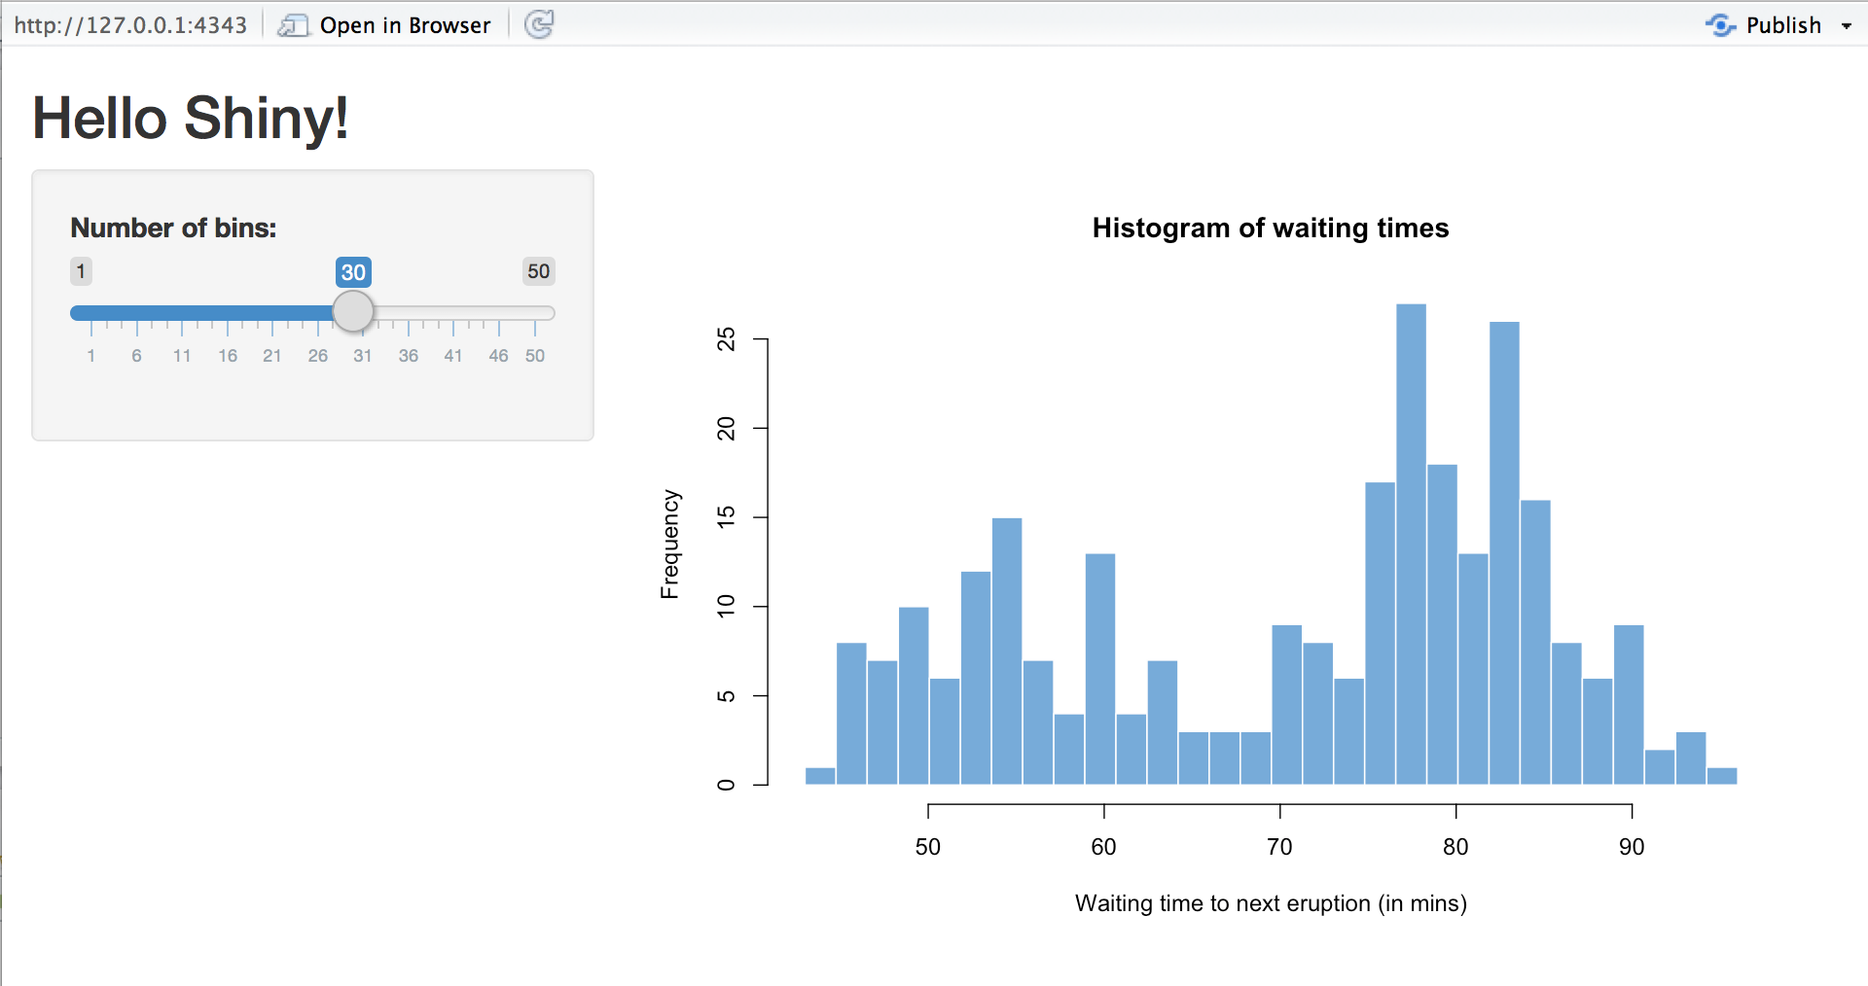

What is shiny? A FRAMEWORK
Shiny apps are hosted by a computer running R
https://pix4free.org/assets/library/2021-01-12/originals/laptop_notepad_pen_cafe_coffee.jpg

Slide 6
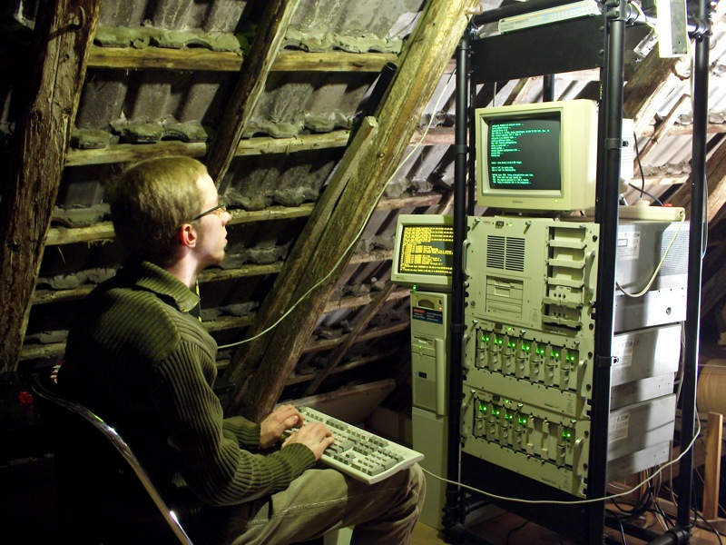
What is shiny? A FRAMEWORK
Shiny apps are hosted by a computer running R
https://www.flickr.com/photos/rudolf_schuba/153225000

Slide 7
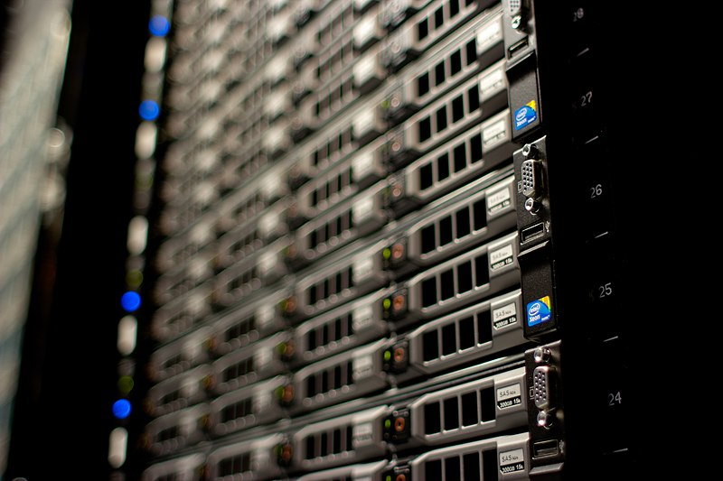

What is shiny? A FRAMEWORK
Shiny apps are hosted by a computer running R
http://www.mojimade.com/cloud-caf-stickers
https://commons.wikimedia.org/wiki/File:Wikimedia_Foundation_Servers-8055_17.jpg

Slide 8



What is shiny? A FRAMEWORK
http://www.mojimade.com/cloud-caf-stickers
https://commons.wikimedia.org/wiki/File:Wikimedia_Foundation_Servers-8055_17.jpg

Slide 9


What is shiny? A FRAMEWORK
http://www.mojimade.com/cloud-caf-stickers
https://commons.wikimedia.org/wiki/File:Wikimedia_Foundation_Servers-8055_17.jpg

Slide 10
What is shiny? A FRAMEWORK
http://www.mojimade.com/cloud-caf-stickers
https://commons.wikimedia.org/wiki/File:Wikimedia_Foundation_Servers-8055_17.jpg

Slide 11

What is shiny? A FRAMEWORK
http://www.mojimade.com/cloud-caf-stickers
https://commons.wikimedia.org/wiki/File:Wikimedia_Foundation_Servers-8055_17.jpg

Slide 12
What is shiny? A FRAMEWORK
http://www.mojimade.com/cloud-caf-stickers
https://commons.wikimedia.org/wiki/File:Wikimedia_Foundation_Servers-8055_17.jpg
UI.R
Server.R

Slide 13
What is Shiny? User Interface & server
UI.R
Layout
Inputs
Text fields, buttons, etc.
File uploads
Mouse clicks, drags, etc.
Outputs
Text
Tables, figures, media, etc.
File downloads
Server.R
Handle data and logic
React to changes
Observe inputs
Update outputs
Trigger side effects
Maintain state
Data, inputs, outputs
Dynamic/intermediate data

Slide 14
Hello, world!

Slide 15
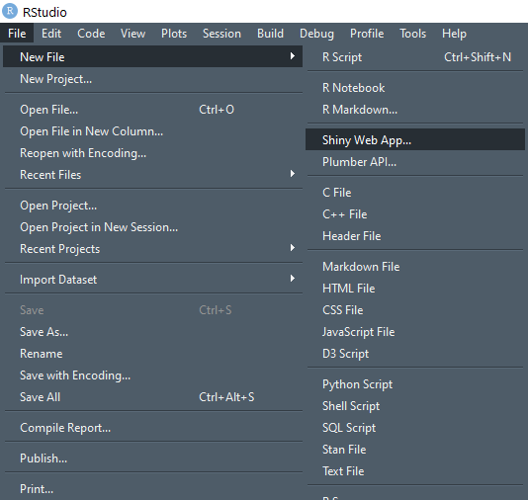
Hello, world! Create a new shiny app
RStudio
develops shiny, tidyverse, etc.
built in support for shiny apps

Slide 16
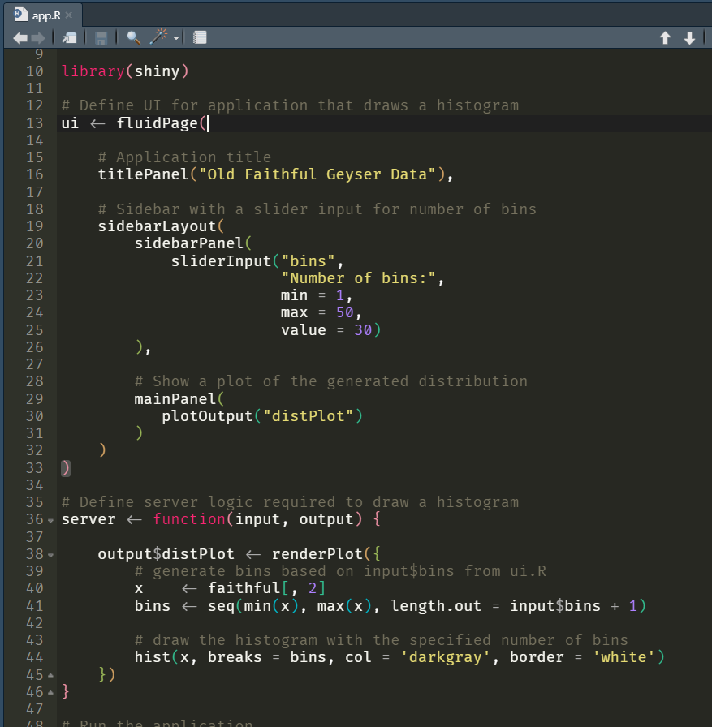
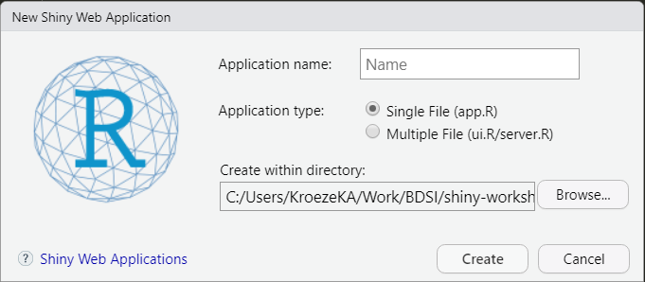
Hello, world! Create a new shiny app
Single file app.R
Portable
Fine for small apps

Slide 17
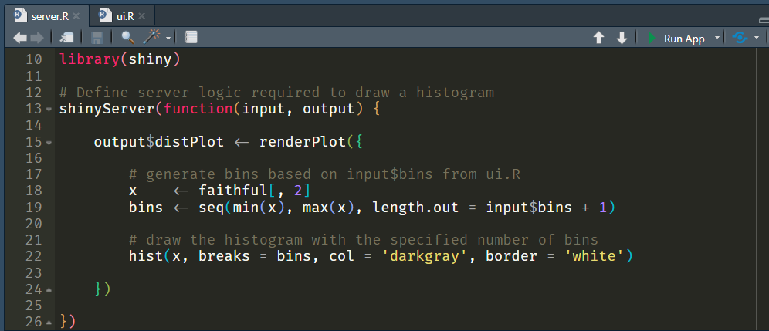
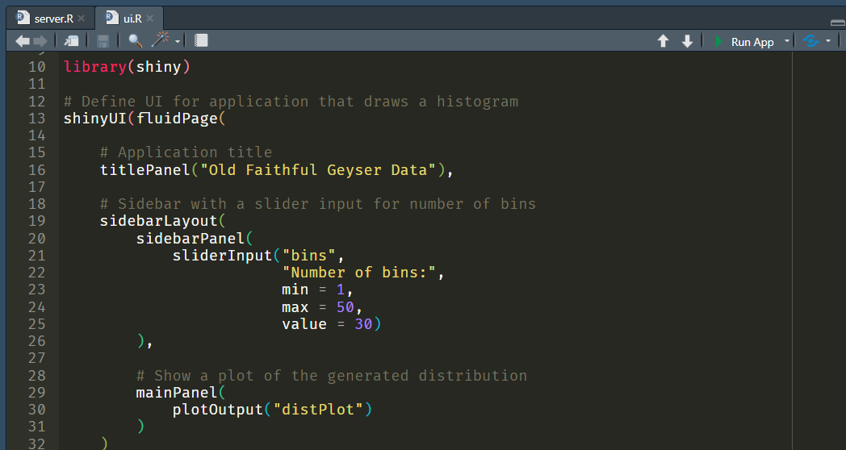
Hello, world! Create a new shiny app
Separate server.R and ui.R files
Separate concerns
Fine for smallish apps
Consider using a project…

Slide 18
Hello, world! Create a new shiny app
Create a Shiny App Project
Separate ui.R and server.R
Easy to add extra code/files
Dependency management (renv*)
History, settings, etc.
Scales from small to large apps

Slide 19
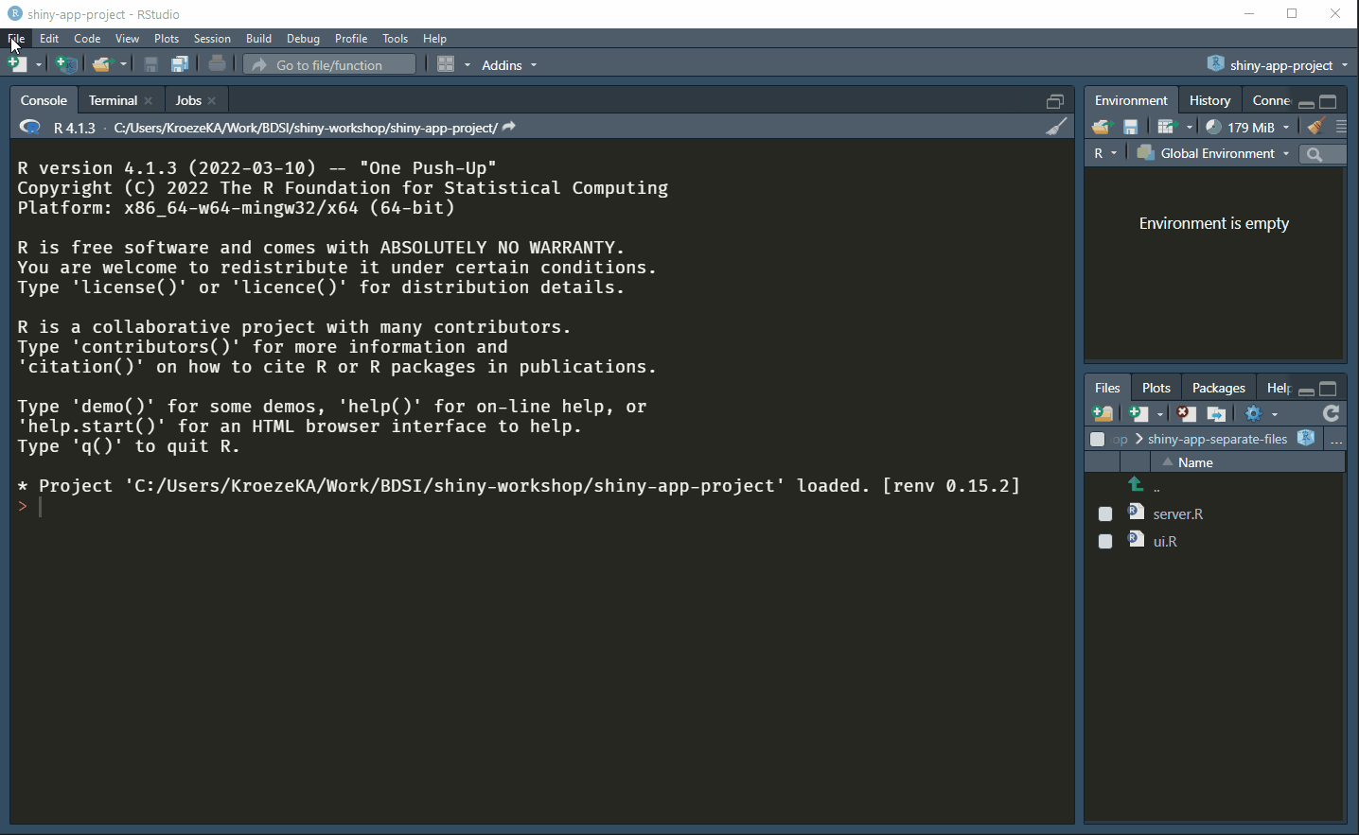
Hello, world! Create a new shiny app

Slide 20
A sidenote: RENV
Have you ever been frustrated with…
Packages not installing because you didn’t have admin permissions?
Different projects using different versions of packages?
Old projects not working after a package updated?
Using shared R code with missing packages?
Of course you have!

Slide 21
A sidenote: RENV
renv solves dependency hell
Creates a local library for each project
Tracks a ‘lockfile’ with specific versions of packages
Makes package installs quicker* by keeping a cache
Seamlessly integrates with existing workflow
renv guarantees your code is reproducible
https://rstudio.github.io/renv/articles/renv.html

Slide 22
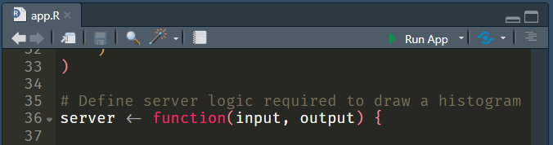

Hello, world! Your first shiny app
Create a Shiny App Project
Change the title to “Hello, World!”
This is traditional, other titles are not acceptable.
Run your app

Slide 23
Hello, world! Your first shiny app
Change lines 48-49 to:
Restart the app
Change the input, see the output update.
# Run the application
shinyApp(ui = ui, server = server, options = list(display.mode = "showcase"))

Slide 24
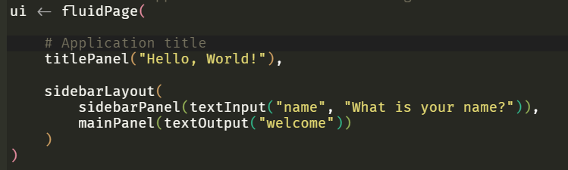
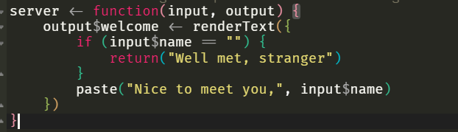
Hello, world! Your first shiny app
Cheat sheets are your friend Help > Cheat Sheets > Web applications with Shiny
UI
- sliderInput(“bins”)
+ textInput(“name”)
- plotOutput(“distPlot”)
+ textOutput(“welcome”)
Server
- renderPlot(“distPlot”)
+ renderText(“welcome”)

Slide 25
Hello, world! Make it yours
Cheat sheets are your friend Help > Cheat Sheets > Web applications with Shiny
Keep it simple
Stick to a basic use case – we’ll add complexity later
Load any data you need
UI
Add/change inputs & outputs
Change layout, labels, texts
You are now allowed to change the title
Server
render[Text/Plot/Table]

